Slide 1
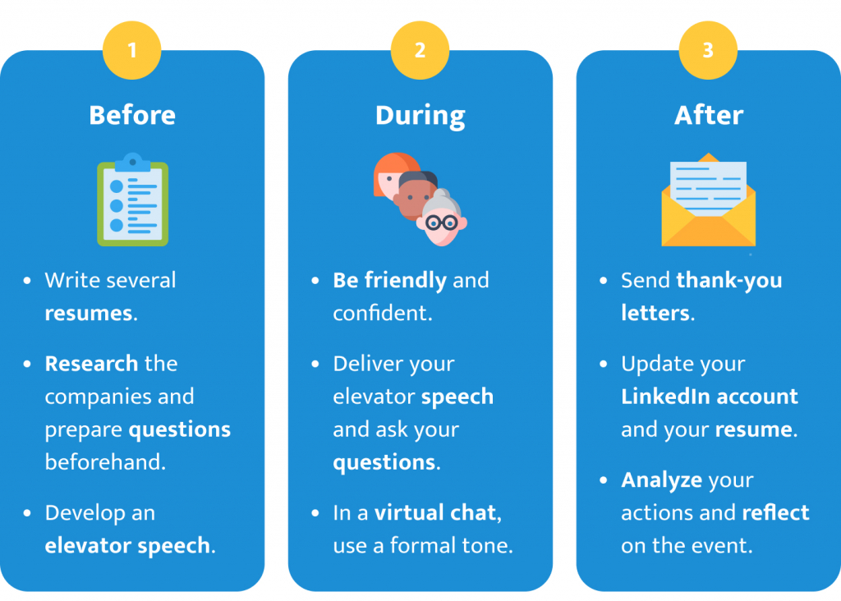
M02 L10 Quiz 1, GE02 and Career Prep

Slide 2
Today
Quiz 01
Lab: Fix Bugs and Refactor your Library App Code
Review CS2050 Agile Software Development and look at the solution posted in announcements.
You do not need to have your code exactly like mine but compare to see what questions you have.
Fix Bugs
Refactor your code to make it easier to test and add new features (M02 GE coming next week)
Career Prep:
1 Draft a Resume

Slide 3
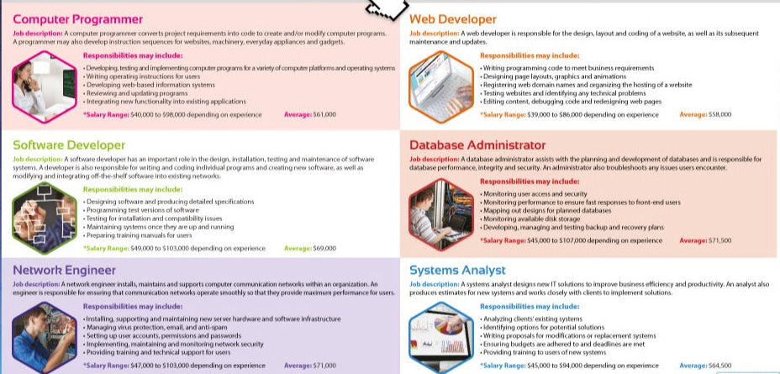
Careers

Slide 4
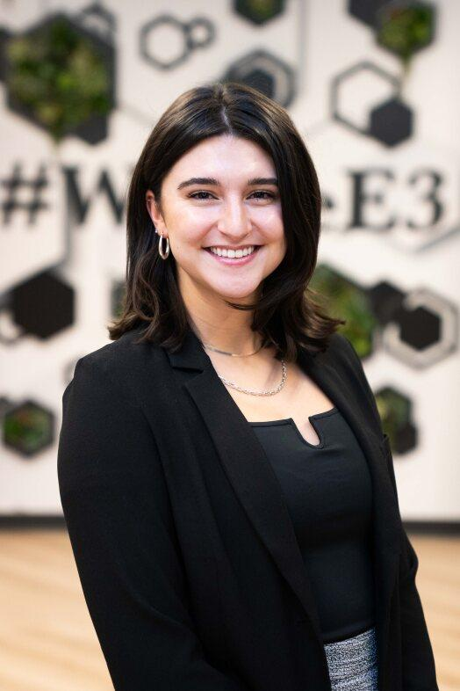


Career Fair Prep
CS Squared Community is hosting a workshop next Sep 23, 2:15-3:15pm (AES 385) and Sep 24, 2:15-3:15pm (AES 490) to help students draft a resume and work on their elevator pitch. If you want to share with your classes.
The STEM Career Fair is on Thursday Sept 25th. https://msudenver-csm.symplicity.com/events/%20STEMF25/overview
The Fall Job and INternship Fair will be Oct 16 https://msudenver-csm.symplicity.com/events/FJIF25/overview.
Matthew Demerson (mademerson@msudenver.edu) manages Industry Partnerships in Electronics, Technology and Information and is located in the Administration Building, Suite 270B
Makena will be our guest speaker on September 30th to discuss internships and jobs. She will provide you with tips for applying and interviewing.

Slide 5
Preparing for Career
Explore Entry Positions
https://www.indeed.com/jobs?q=entry+level+computer+science+developer&l=Denver%2C+CO&radius=100&sc=0kf%3Aexplvl%28ENTRY_LEVEL%29%3B&from=searchOnDesktopSerp&vjk=c5b0a4fbb465d803
Read examples
Elk Stack Administrator
Junior WordPress Web Developer
Junior Software Engineer (Java)
Full Stack Software Developer - Junior/Mid-Level
What information should you include in our resume?

Slide 6
Crafting Your Technical Resume
Overview: Learn how to show your abilities to potential employers
Objective: Learn to transform class assignments and projects into resume-ready content.
Focus Areas:
Summary: A snapshot of who you are.
Skills: A categorized list of your technical and soft skills.
Relevant Experience: Projects and class assignments presented as professional experience.
In a document create the following Headings
Summary
Education
List of skills
Relevant Experiences

Slide 7
Effective Summary
Provide a quick, impactful introduction that highlights your technical expertise and leadership qualities.
Key Points Resume Summary :
Who you are (your technical role)
Your strongest technical and soft skills
Customization for the specific job or opportunity
https://resume.io/resume-examples/computer-science#make-use-of-a-summary
CS 1/CS 2 Java Student: Current computer science student with a solid foundation in object-oriented programming and problem-solving in a collaborative environment. Completed iterative project demonstrating proficiency in Java, data structures, and algorithms. Implemented Software development life cycle to build maintainable and testable solutions.
Web App Developer: Current computer science student with experience in Agile methodologies to develop a full stack solution utilizing test driven and behavior driven development. I have a strength in learning how to learn as demonstrated in building a solution utilizing various technologies and the Rails Model View Controller framework.

Slide 8
Engineering Action Words & Agile Terminology
Blend these action words and agile terms into your project descriptions and skills sections.
Example: "Analyzed user stories, used test driven development to design modular solution, implemented and unit tested to build a solution.
This language helps demonstrate that you are not only technically proficient but also experienced in modern, collaborative development practices.
Use action verbs to clearly communicate your contributions and impact.
Examples for Computer Science:
Analyzed, Designed, Developed, Created, Implemented, Refactored, Debugged, Integrated, Secured, Architected, Configured, Tested, Coordinated, Delegated, Scheduled, Evaluated, Devised, Maintained, Solved, Presented, Investigated, Researched, Planned
Highlight experience with agile methodologies to show your adaptability and teamwork in fast-paced environments.
Key Agile Terminology :
User Stories, Acceptance Criteria, Iteration, Test Driven Development (TDD), Behavior Driven Development (BDD), Continuous Integration, Sprint Planning, Daily Stand-ups, Backlog, Sprint Retrospective,

Slide 9
Highlighting Your Skills
Computer Science Resume Relevant Skills Showcase your best technical and soft skills in a clear, organized format.
Organize your skills into categories (e.g., Programming Languages, Tools, Methodologies, Soft Skills).
Hard Skills | Soft Skills
Technology skills | Communication
Coding Skills | Creativity
Software development knowledge | Attention to detail
Analytical skills | Time management
Technical writing | Organization
Problem-solving | Collaboration
Planning skills | Leadership

Slide 10
Example Skills
CS 1/CS 2 Java Student Skills:
Programming Languages: Java
Core Concepts: Object-Oriented Programming (OOP), Data Structures, Algorithms, Debugging
Software Development: Analyze requirements, break into smaller parts, create unit test cases, implement and test, Technical Documentation
Development Tools: Eclipse, Git, Github
Soft Skills: Problem-Solving, Teamwork, Oral and Technical Written Communication
Full Stack Developer Skills:
Programming & Web Development: Ruby on Rails, HTML, CSS, Bootstrap, Devise, Rspec, Selenium
Tools: VSCode, Git, Github, Docker
Agile Software Development: Scrum, Leadership, Unit Test, TDD, BDD, Sprints, Technical Documentation
Soft Skills: Creativity, Problem-Solving, Teamwork, Team Leadership, Communication, Time Management

Slide 11
Translating Projects & Class Assignments into Experience
Relevant Experience Demonstrate your hands-on experience by presenting class projects or assignments as professional achievements.
2 or 3 relevant experiences to your major
Class projects (Homework can be made into project)
Personal Projects
Work experience from the field if you have any
Key Components:
Project Title & Duration: Clearly indicate the project name and timeline.
Technologies & Methods: List the tools, programming languages, and methodologies used.
Responsibilities & Achievements: Describe your role, key features developed, and measurable outcomes.
I don’t think have any
Yes you do!

Slide 12
Experience Examples
CS 1/CS 2 Java Project:
Instructor Grade Management System (October 2024 – December 2024)
Built a Java Object Oriented Solution to managing student grades over 3 iterations
Analyzed User Stories, broke into smaller tasks and development unit test cases
Applied algorithms and OOP principles such as encapsulation and inheritance.
Conducted unit testing to verify functionality and improve code reliability.
Online Library Management System (October 2024 – December 2024)
Developed a dynamic website using Ruby on Rails, HTML, CSS, and Bootstrap.
Designed a user-friendly interface allowing users to add, edit, or remove information.
Implemented secure login functionality using Devise
Integrated Rspec unit testing and integration testing with Selenium
Roles: As Scrum coach led daily stand up, as tech lead helped problem solving, contributed to team documentation

Slide 13
Customizing Your Resume for Each Opportunity
Blueprint Strategy:
Maintain a master resume with a library of summaries, skills, and project examples.
Customize a copy of your resume for each job application by selecting the most relevant content.
Tips:
Align your language and content with the employer’s job description.
Emphasize the aspects of your experience that match the position’s requirements.

Slide 14
Summary
Recap:
A strong technical resume is built around a concise summary, an organized skills section, and detailed project examples.
Customization is key—tailor each resume to the specific opportunity and highlight both your technical and leadership strengths.
Future Collaborations
Draft summaries, selecting, or presenting projects.
Share their drafts and get peer feedback.

Slide 15
Prepare Elevator Pitch
A short, simple speech (30–60 seconds) that introduces who you are, what you do, and what you are looking for.
Introduction:
Start with a greeting and your name.
Example: "Hello, my name is [Your Name]."
Your Background:
Mention your current role or field.
Example: "I am a student of Computer Science at Metropolitan State University and have been developing Java programs"
Your Strengths and Goals:
Share one or two skills or experiences.
Example: "I have experience in developing solutions and and I enjoy collaborating to solve a problem."
Add your goal: "I am looking for opportunities to learn and grow."
Continue Conversation
I am eager to …., Can you tell me more about … internship opportunities, company careers, etc.

Slide 16
Examples
Introduction: "Hi, I'm [Your Name], a Computer Science major at Metropolitan State University, expected to graduate in [Month, Year]."
Background & Expertise: "I have experience in [Full Stack Development/Java Programming/Agile Methodologies] with hands-on experience in building modular and testable solutions."
Key Achievements: "I have iteratively developed an online library management system, where I implemented various features and ensured high code quality through test-driven development."
Soft Skills & Value Proposition: "I excel in collaborating on a team and problem-solving. I communicate complex technical ideas clearly orally and in written technical documentation, ."
Continue Conversation: "I'm eager to learn more about [company] and would love an opportunity to grow my skills. "

Slide 17
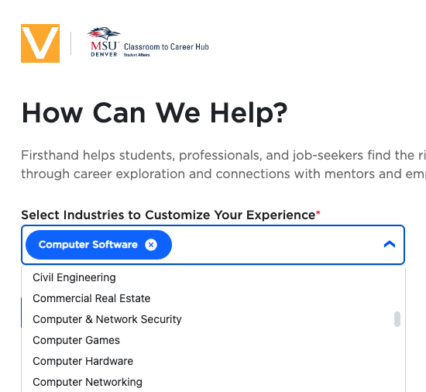
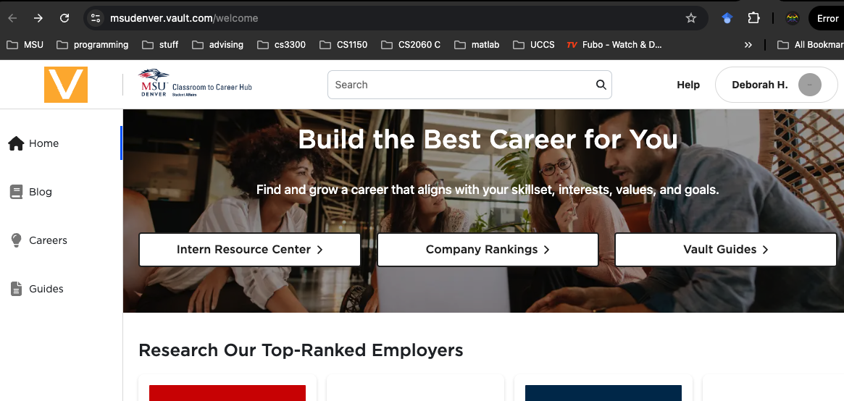
MSU Resources
Matthew Demerson (mademerson@msudenver.edu) manages Industry Partnerships in Electronics, Technology and Information and is located in the Administration Building, Suite 270B
Classroom to Career Hub Events - MSU Denver
Vault Career Resources provided by MSU Denver

